Slide 1
K.RAMAKRISHANAN COLLEGE OF ENGINEERING (AUTONOMOUS)
WEBSITE BLOCKER
MEMBERS:
MARIYAN.R IT2025
GUIDE:GAYANA.R AP/IT SRI HARI.V IT2049
VIMAL.P IT2057

Slide 2
INTRODUCTION
The website blocker denies access to the specific IP address of the client.
The blocking doesn‘t means that the website will not operate.The content or page of the website will not show to the user anymore.
The website blocker is a tools that can help to overcome the temptation of distracting and addictive tech.

Slide 3
OBJECTIVE
Website Blocker is a tool that denies the access to certain websites TEMPORARILY or PERMANENTLY.
To use the internet safely and distractions,all the websites can be blocked.

Slide 4
ABSTRACT
The user can enter multiple websites to block that derives the concentration during the working hours.
On clicking the block button ,the if statement will check the condition if the website is already blocked. If so ‘already blocked’ is displayed else block all the websites that are entered and print ‘blocked’.
The same website can be unblocked by the user using the unblock button if it’s needed.

Slide 5
SYSTEM REQUIREMENTS
HARDWARE REQUIREMENTS:
Processor :Pentium IVl
Hard disk capacity :40 GB
Monitor :21 “Samtron Monitor”
Internal memory capacity:128 Mb
Keyboard :Logitech of 104 Keys
Cpu clock :1.08 GHZ
Mouse :Logitech Mouse

Slide 6
SOFTWARE REQUIREMENTS
Operating system: windows 10 Front end :python 3.8.3

Slide 7
EXISTING SYSTEMS
SELFCONTROL:
This website blocker is only officially available for macOS, but the charm is all in it’s simplicity and minimalist design. Rather than use extensions, SelfControl blocks websites using the hosts file. In effect, this means that the block is system-wide
DISADVANTAGES:
User will be able to get around the block by changing the time or restarting your computer.
Any advanced functionality is not available
Generally,it is available for macOS, nothing else

Slide 8
PROPOSED SYSTEM
Website blockers are software programs that are used to block any websites on the internet and prevents others from accessing them.
They are most widely used as browser extensions that “Blacklist” websites .
So that the results of those websites can’t be viewed.
But here, the aim is to create a program using python to block websites and Makes that as it cannot Be accessed by the user.

Slide 9
To create this, one must need basic understanding of python file I/O, python data structures, and a basic understanding of Tkinter library.
The Tkinter library is used to create the GUI, and it comes pre-installed with Python.

Slide 10
Localhost :
It is a set of hostnames that refers to the local computer that is used and that is used to access the network services being used by The computer. These hostnames usually start with ‘127’.
Hostname –
It is an IP address that is used to identify the computer during electronic communications.

Slide 11
MODULE DESCRIPTION
Creating gui window:
Tk()- helps to create an empty window where the labels and buttons are added. Thus a space named window is created Geometry() – this function is used to give size to the window. Minsize(), maxsize() – this function is for giving the minimum and maximum size to the window. Title() – provides an appropriate title to the window.

Slide 12
MODULE DESCRIPTION
Block Function:
Get() – this method is used to get the text that is added to the enter_website label. Open() – this is for opening the host file. Here the host file is opened in r+ mode which is read plus write mode. Split() – this method is used to separate the content of the text area.

Slide 13
MODULE DESCRIPTION
Unblock Function:
The Unblock() function is created so that the user can unblock a website that is already blocked if needed and it is present in the host file.
If a website is blocked and if the Unblock button is clicked a label “Unblocked” is displayed.
If a website is already Unblocked and isn’t a part of the host file then display label – “Already Unblocked”.

Slide 14
MODULE DESCRIPTION
Get() – this method is used to get the text that is added to the enter_website label
Open() – this is for opening the host file. Here the host file is opened in r+ mode which is read plus write mode.
Split() – this method is used to separate the content of the text area.

Slide 15
MODULE DESCRIPTION
Creating Labels and Buttons:
The method Label() is used to create a label.
For the text area, we use the method Text().
To place both of these to the window we use the place() method and inside it we give the values to x and y.

Slide 16
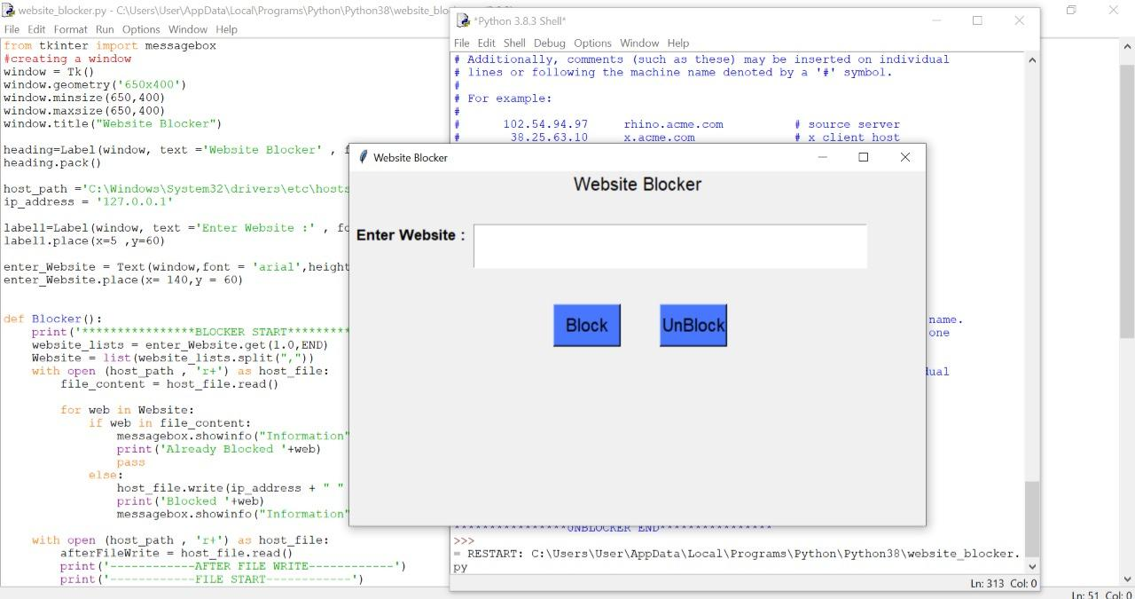
WEBSITE BLOCKER WINDOW

Slide 17
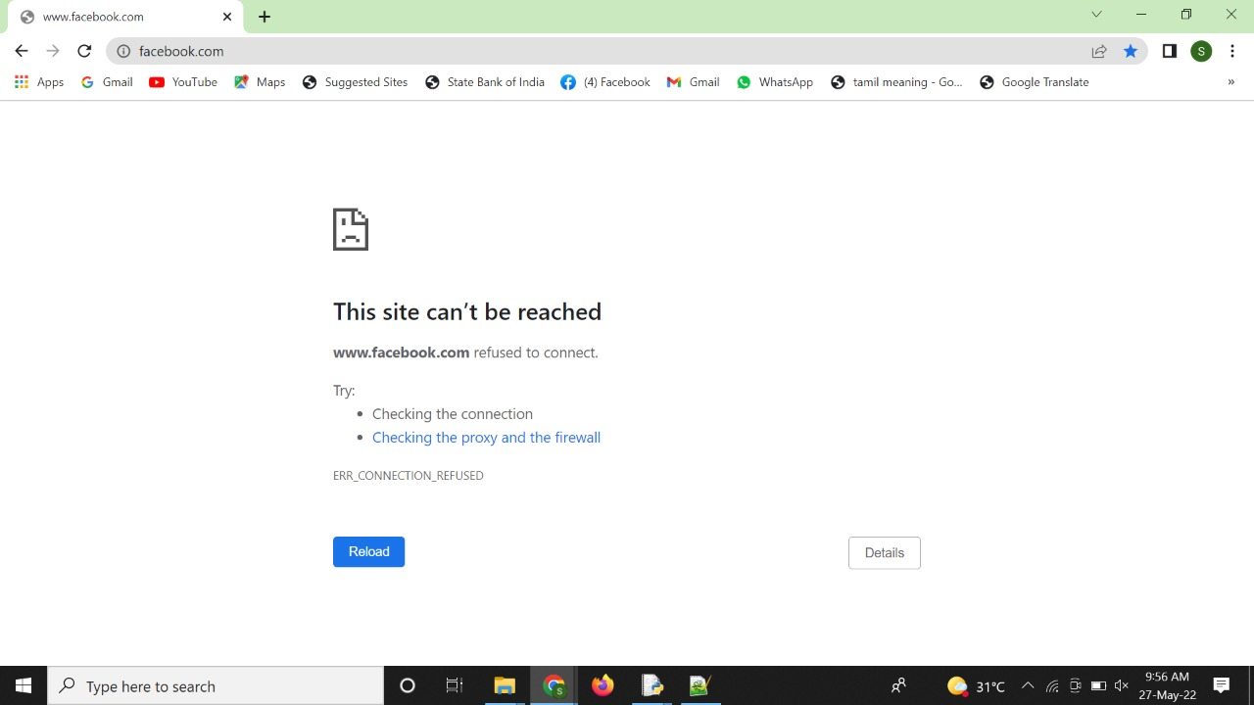
BLOCKED WEBSITE

Slide 18
THANK YOU!!!!!!

